Slide 1

Free healthcare resources for the underserved
Free Health - Team 5.11
Team Lead – Robert davila, RN
Team members
Onike Willams, MSN, NP-C, PHN
Ferdinand Mabeya Process Eng., Grad Student
Ann Garton, MSN, RN, CNE
Sam Robinson, Microsoft Advisor
Aruna, technical Coach, prototyping
COACHES
Rhonda manns, pitch coach
Nakia Melecio, technical Coach
TEAM – 5.11 Free Health
Notes:
Pitch:

Slide 2
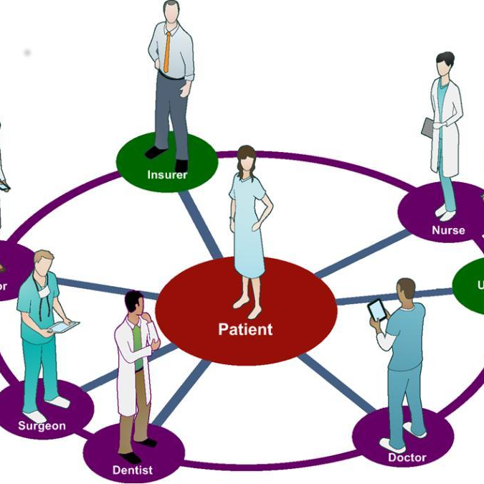
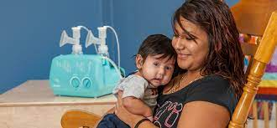
TEAM – 5.11 Free Health
Notes:
Hi my name is Robert, I am a public health nurse with CPS
I want to share an important story with you.
I was approached by a mother who wanted to breast feed, she wasn't qualified to receive a breast pump for free.
I called around, talked to different coworkers. It took me 2 hours to find a colleague in the nutrition department to locate a free breast pump.
In Child Protective Services time is of the essence, if I did not find it, it would have affected this working mother, and possibly her custody of her children. How would my coworkers handle this same situation? Take hours or possibly not find the resource at all? That is why we created a system to share collective knowledge that is available in seconds.

Slide 3
The Problem
WHO
Health and human service individuals including case managers, public service personnel, primary care givers and others
WHAT
Source to find health resources that meet individual client needs in a compassionate, and culturally sensitive way
TEAM – 5.11 Free Health
Notes:
The problem we aim to address is for health and human services individuals including case managers, public service personnel, primary care givers and others that face the problem of meeting their individual client needs in a compassionate and culturally sensitive way.
The current system cannot find LOCAL resources available. Resulting in cynical workers using ineffective resources.
Not local to me, for someone who was underinsured, it made it an issues.
Who: Health and human service individuals including case managers, public service personnel, primary care givers and others.
WHAT
Source to find health resources that meet individual client needs in a compassionate, and culturally sensitive way
The problem is that my colleagues could not find local resources available. Resulting in the creation of cynical workers using ineffective resources.
Health and wellness overall in disease process
Cost information and access and place people feel comfortable
And resources that are valid
User friendly
More
Access with compassion
May be coping mechanisms
No judgement
No cultural competence
NO JUDGING
Need to connect
People from poverty who needs their help
Allows individual to succeed with what hey need
Add guidance for healthcare
Clinician burnout – non -compliance
Feedback loop needed
Convert tribal knowledge to re-usable resource
Move from Google search and find on your won
Adoption?
Who maintains the database
Easy feedbaclk loop
Top of license
Multiple resources presented in multiple formats -= scattered, not centralized , no feedback leading to clients not getting the help they need because of lack of effective resources that meet and deliver what client needs wherever they are.

Slide 4
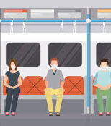

Proposed Solution
TEAM – 5.11 Free Health
Notes:
World Health Organization's definition of person-centered care – giving the right care, by the right person, at the right time. It is powerful to Link the diabetic who is unable to follow the treatment plan or the young new mother to access to the necessary support, the refugee who struggles with translation, and other health literacy barriers to reach their health and wellness goals. We propose a person-centered criteria based chatbot for resource recommendations available to health and human services professionals to provide an accessible system sharing of community resources to increase access. The program would be overseen by a community agent within a county, region, or state depending on the needs of the community. Competition includes other for profit and non profit organizations working towards similar solutions for example - aunt bertha, unite us which could be incorporated into this solution. We believe the social service plan is the ethical and sustainable model through ongoing crowd sourcing, and community adoption plan. Funding which I have experience in with other community projects could potentially come from private and public partnerships including government funded grants, community partnerships and foundations.
We have a prototype started – our example shows how the potential new community nurse, the librarian or other human service professional can assist for example the uninsured new mother find the resources to retrieve the needed breastpump. Our prototype would include resources to answer the needs faced within the community and provide the knowledge needed to improve access across the region.
We believe we have an exciting plan that can impact health equity, increase patient and provider success and improve the health of our communities.
Help us not be so frustrated when clients needs are not being met and Be able to give them the effective tools needed

Slide 5
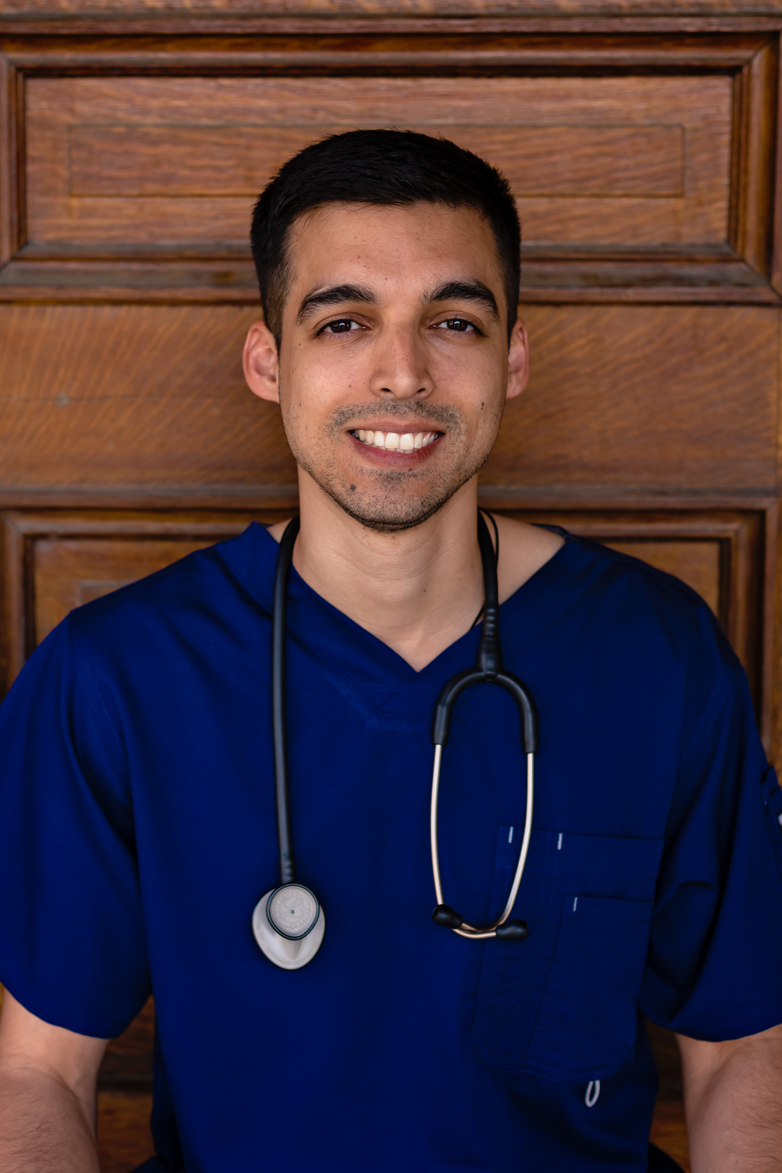

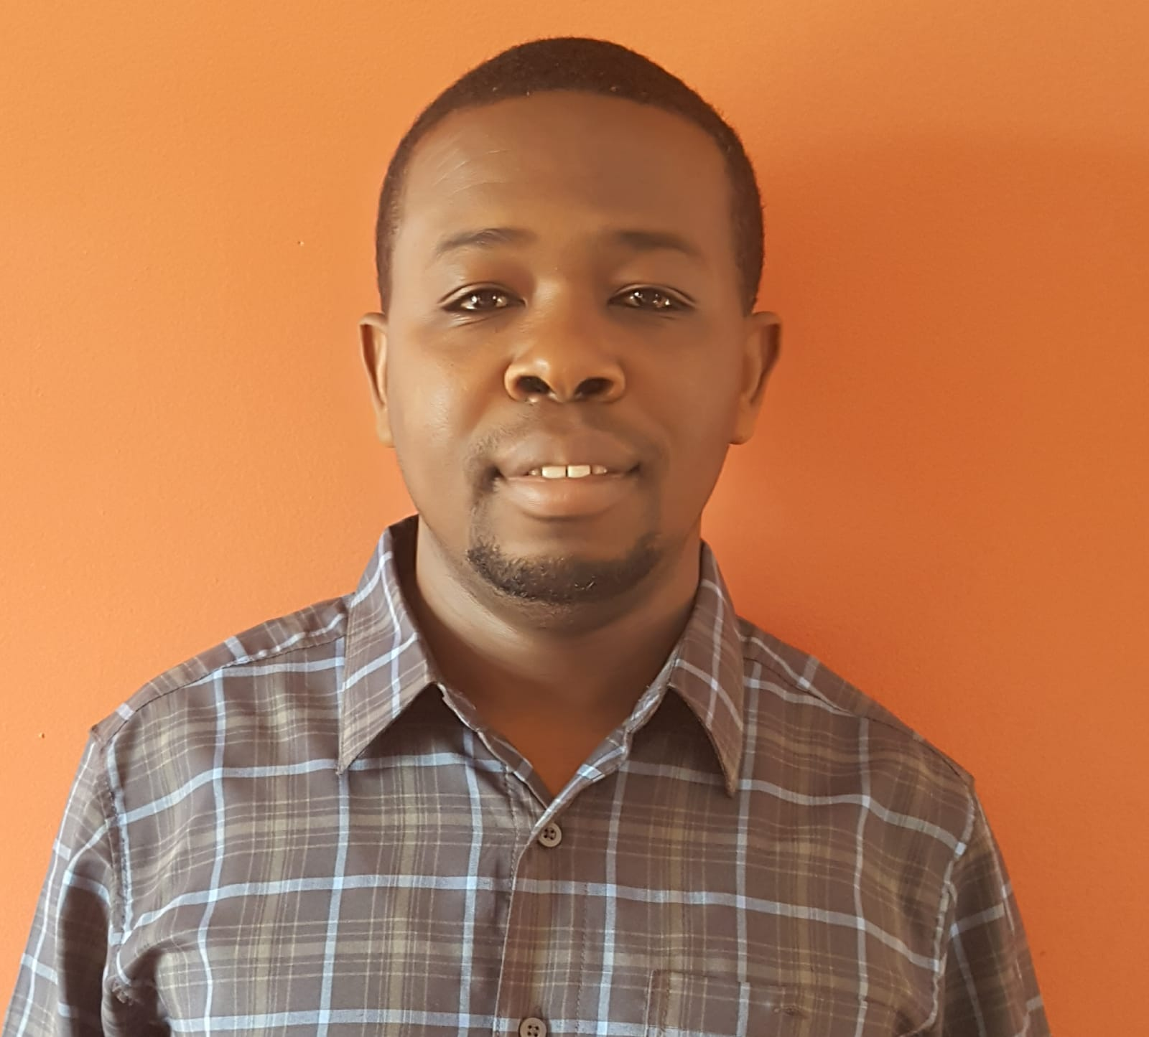
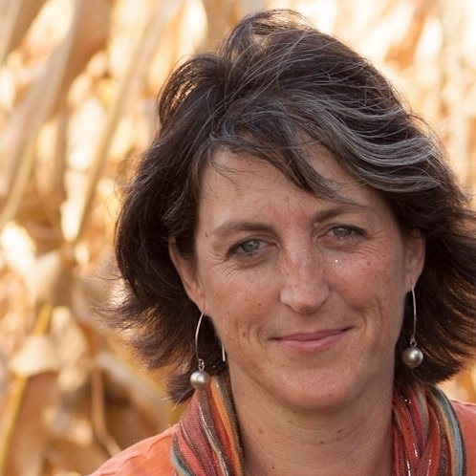
Meet the team
Robert Davilla, RN, PHN
Onike Willams, MSN, NP-C, PHN
Ferdinand Mabeya Process Eng., Grad Student
Ann Garton, MSN, RN, CNE
Aruna, Coach, Prototyping
Nakia Melecio, Coach
Sam Robinson, Microsoft Advisor
TEAM – 5.11 Free Health
Notes:
We have 3 nurses, an engineer and 2 technitians
Robert – PHN Child Protective Services, Southern California
Ann – educator and community health nurse faculty person centered care (PCC) competencies for higher ed and workforce development, DNP student at Indiana weslyn, global population health and immigrant
Onike NP Los Angeles – nursing driven tools and med tech driven tools
Ann – edueducator and community health nurse faculty person centered care (PCC) competencies for higher ed and workforce development, DMP student at Indiana weslyn, global population health and immigrant

Slide 6
Conclusion
This will result in Better Health, Lower Cost and Better Access to health resources across the community
The system will effect systematic change that will allow for better health equity, better health outcomes, and increased access
The system will maximize the use of local resources within the community
The system puts the tools in the hands of those individuals in the best position to effect change
TEAM – 5.11 Free Health
Notes:
Help us not be so frustrated when clients needs are not being met and. Be able to give them the effective tools needed
We believe we have an exciting plan that can impact health equity, increase patient and provider success and improve the health of our communities.

Slide 7
Appendix
TEAM – 5.11 Free Health

Slide 8
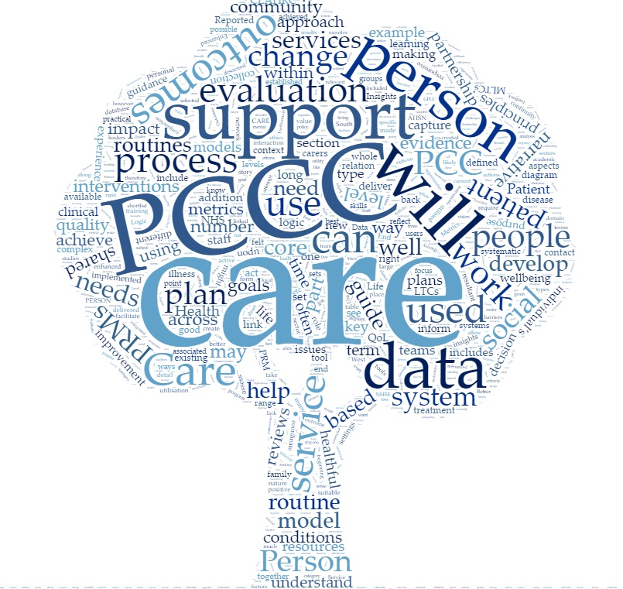
Proposed Solution
What
Criteria based chatbot for resource recommendation with ability to provide for sharing of community knowledge with included feedback and maintenance capabilities
Funding
This solution will be funded by government grants, community partnerships and/or foundations
Adoption
Community evangelists
Regional adoption and localization
Can incorporate commercial offerings, e.g. Aunt Bertha
Sustained through ongoing crowdsourcing
TEAM – 5.11 Free Health
Notes:
We propose a person-centered criteria based chatbox for resource recommendations available to health and human services to provide an accessible system sharing of community resources to increase access. The program would be overseen by a community agent within a county, region, or state depending on the needs of the community. Funding could potentially come from government funded grants, community partnerships and foundations.
WORKFLOW

